Slide 1
Presentation to the Head of purchasing for sweets & candies

Slide 2


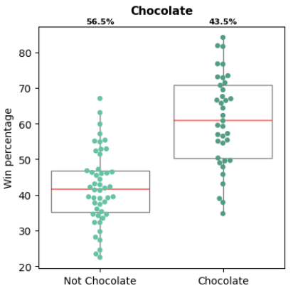
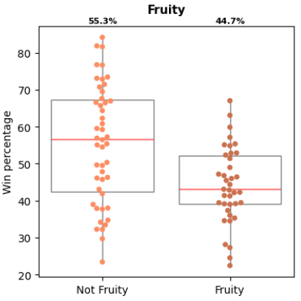
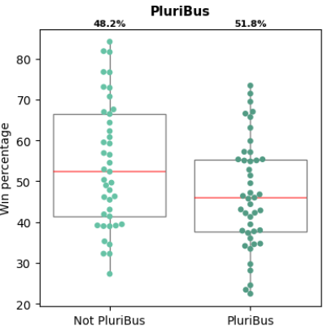
Business Recommendation
Balancing Exploration and Exploitation
Optimizing composition for customer sentiments
Strong predictors for higher customer liking
Newer compositions for market differentiation
These are novel compositions which have not been tried by competition yet and are expected to have high liking.
Chocolate
Fruity
Pluri Bus
Peanut Almondly
Crisped Rice Wafer
Hard

Slide 3
Business Recommendation
Balancing Exploration and Exploitation

Slide 4
Business Recommendation
Modelling Approach

Slide 5
Business Recommendation
Design Space and selection

